Slide 1
客群: 外星投資者 – 我們要賣星球給他們

Slide 2
Null_Pointer_Excepton
Presents
Translating…

Slide 3
Null_Pointer_Excepton
Presents

Slide 4
Solar System Buyer’s Guide

Slide 5
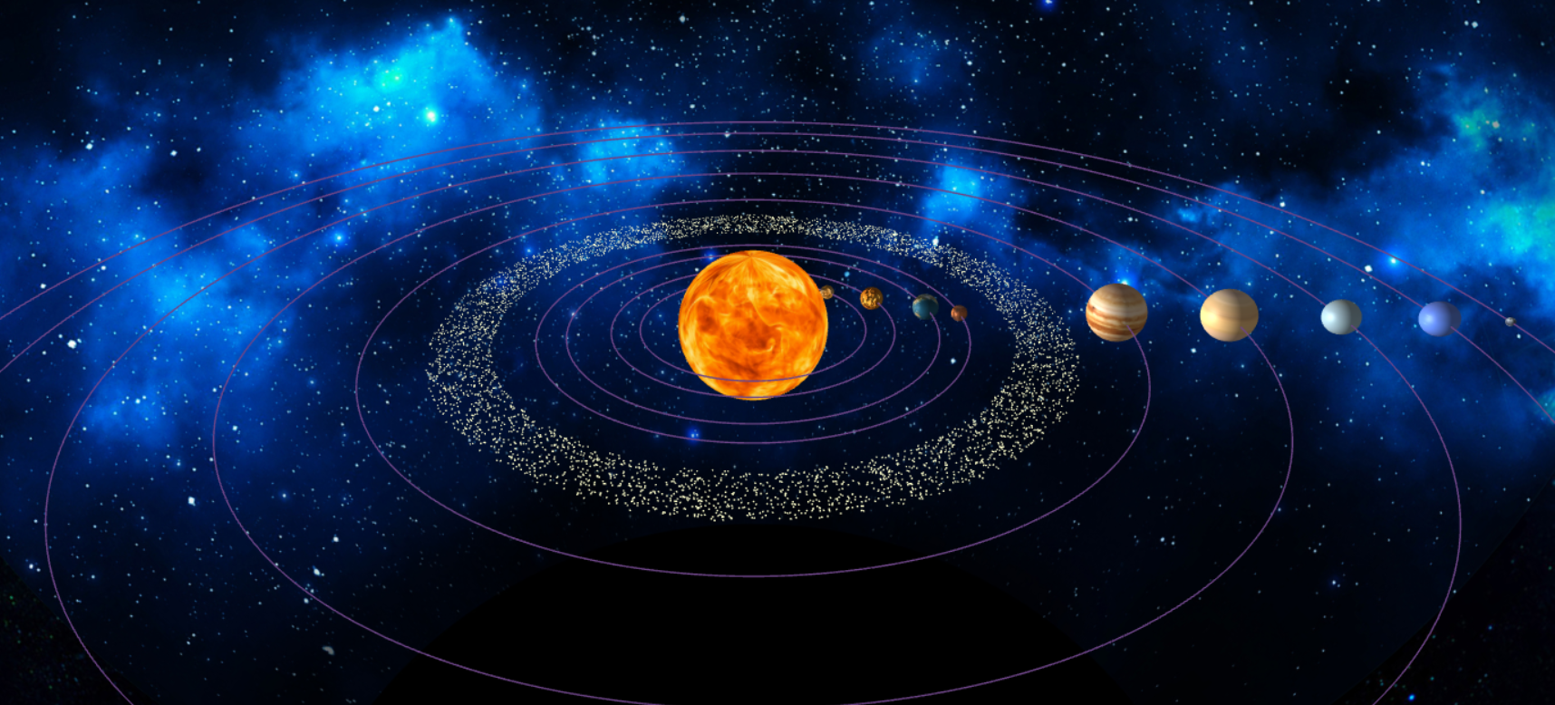

Slide 6
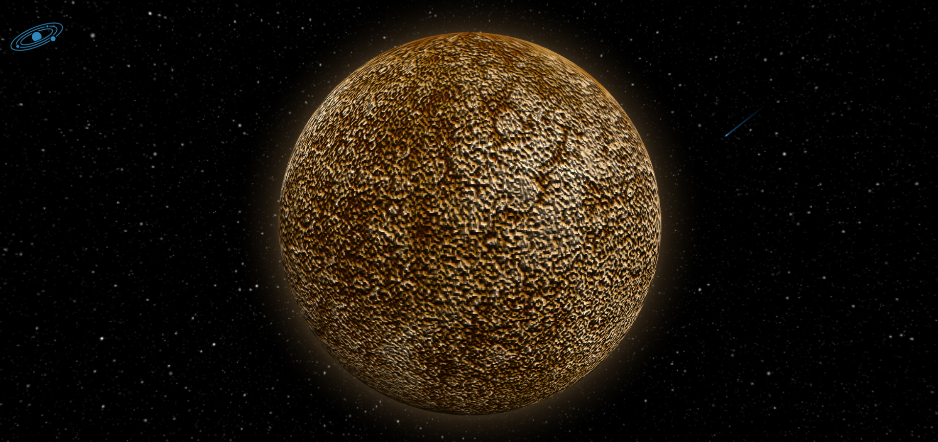
Mercury

Slide 7

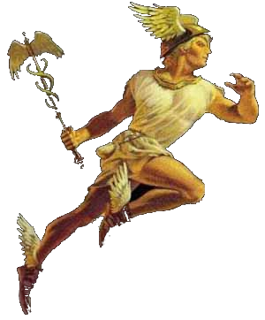
Mercury
Diameter: 3031 miles (4,878 km)
Mass: 3.3011×10^23kg (0.055 Earths)
Composition by volume:
42% molecular oxygen
29.0% sodium
22.0% hydrogen
6.0% helium
0.5% potassium
Trace amounts of argon, nitrogen, carbon dioxide, water vapor, xenon, krypton, and neon
Cost: 909,300 Credits

Slide 8
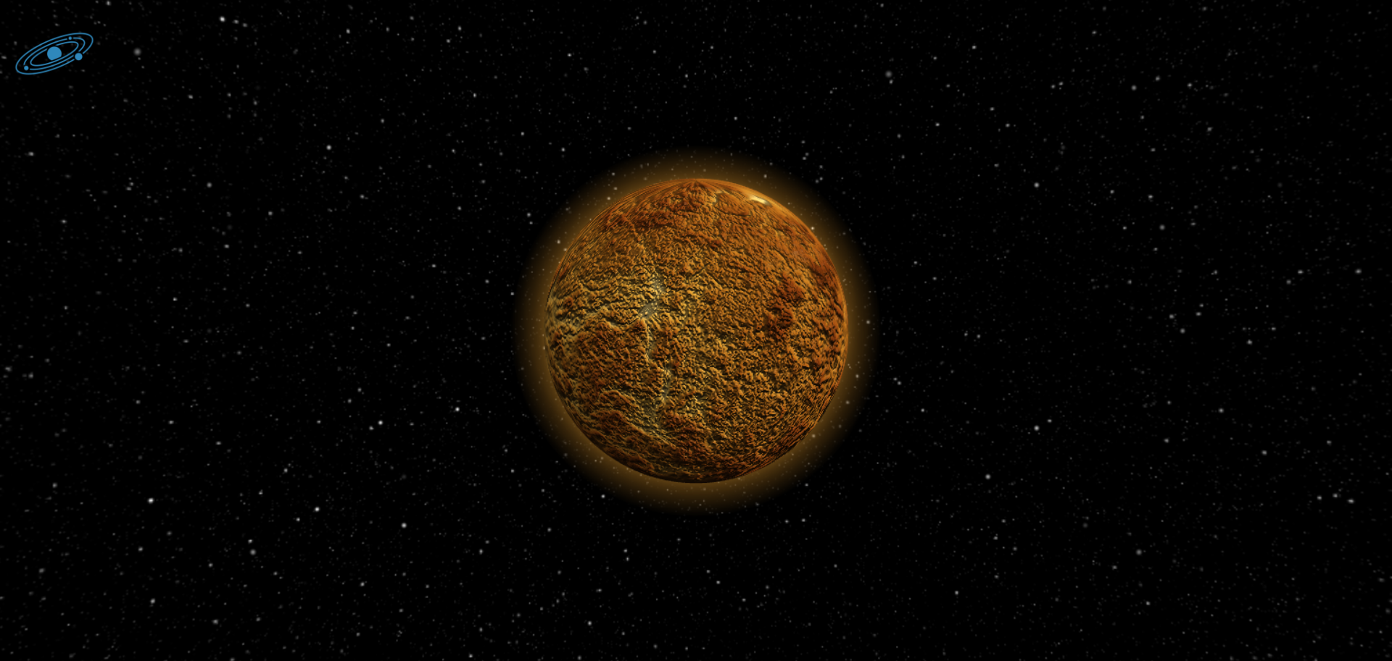
VEnus

Slide 9

Mercury
Diameter: 7,521 miles (12,104 km)
Mass: 4.8675×10^24kg (0.815 Earths)
Composition by volume:
96.5% carbon dioxide
3.5% nitrogen
0.015% sulfur dioxide
0.007% argon
0.002% water vapour
0.0017% carbon monoxide
Trace amounts of carbonyl sulfide, hydrogen chloride, hydrogen fluoride
Cost: 2,256,300 Credits

Slide 10
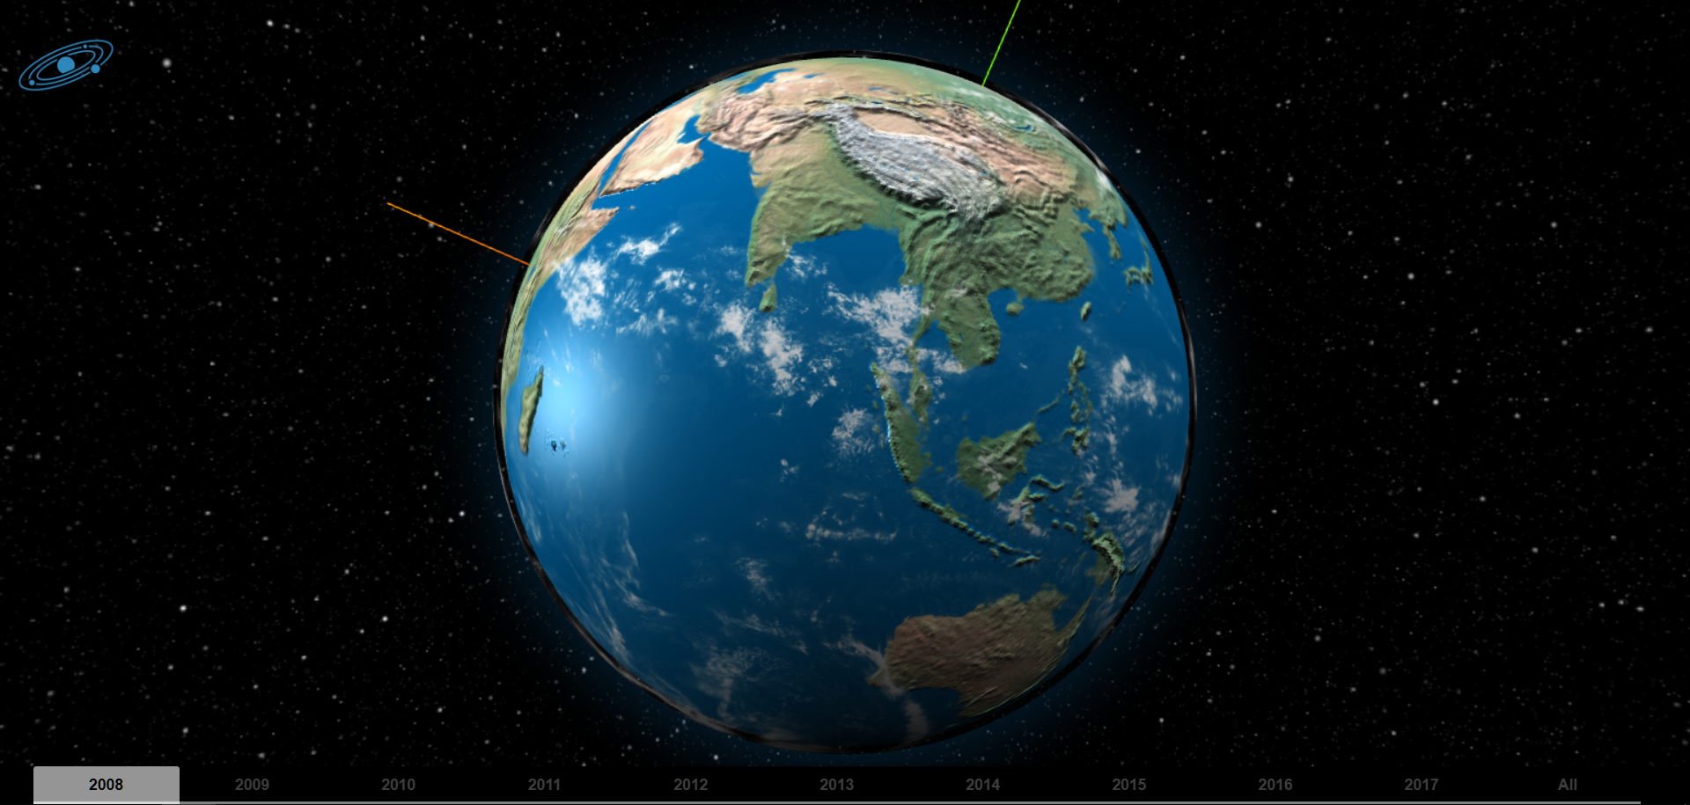
Earth

Slide 11
ipsum

Slide 12
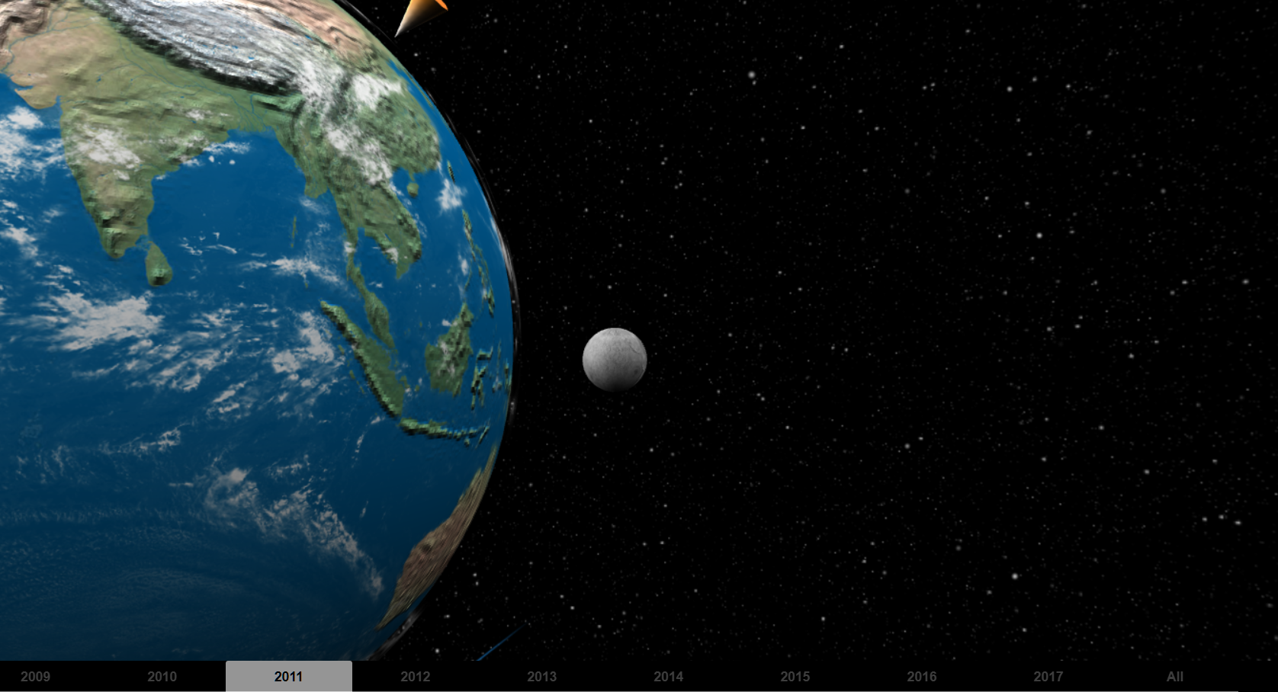

Slide 13
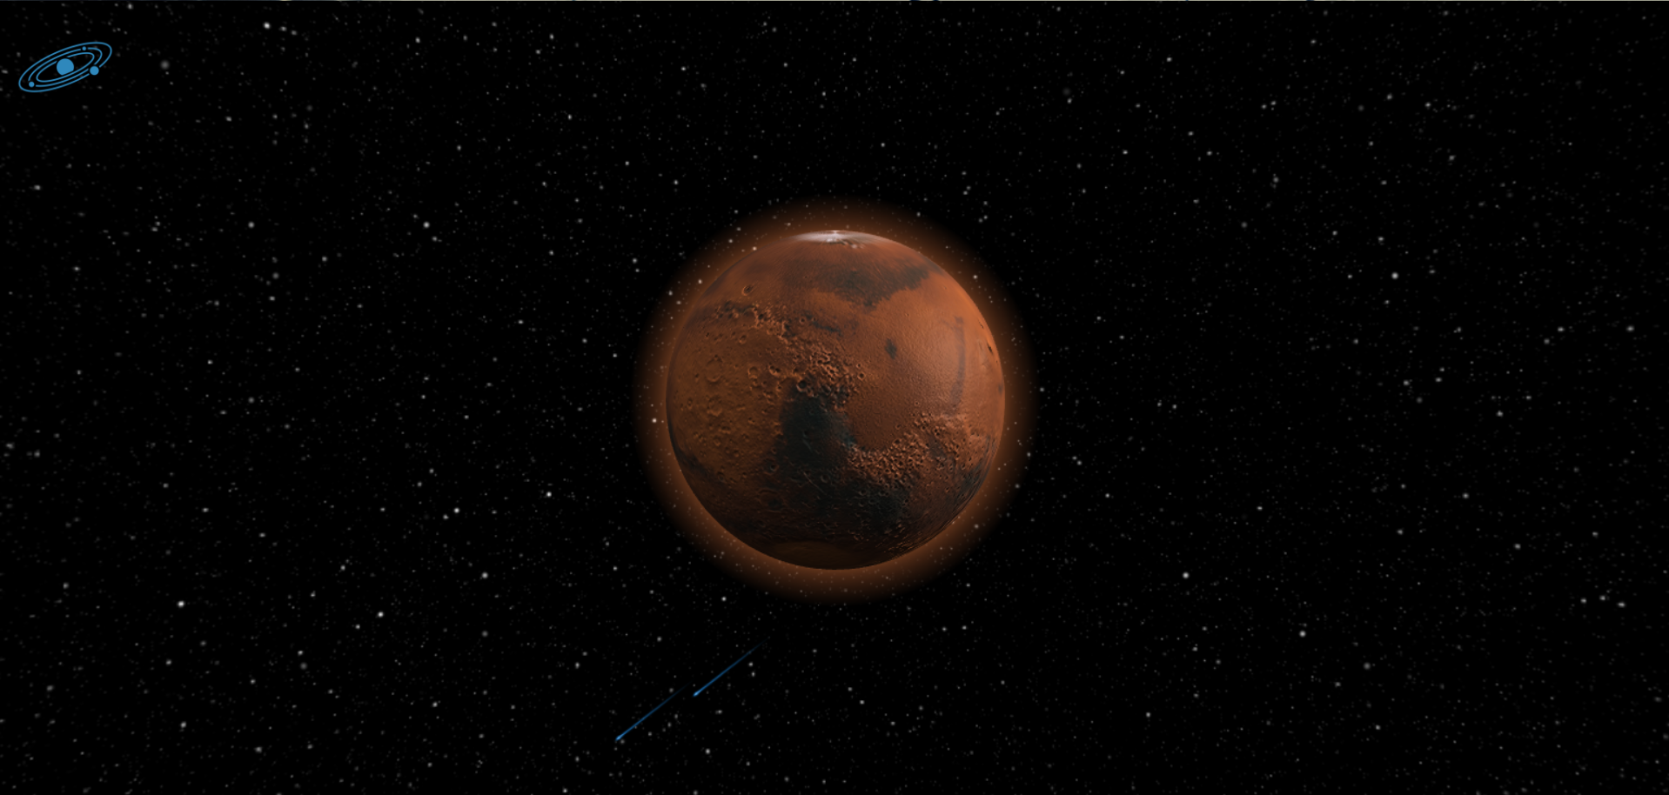
Mars

Slide 14
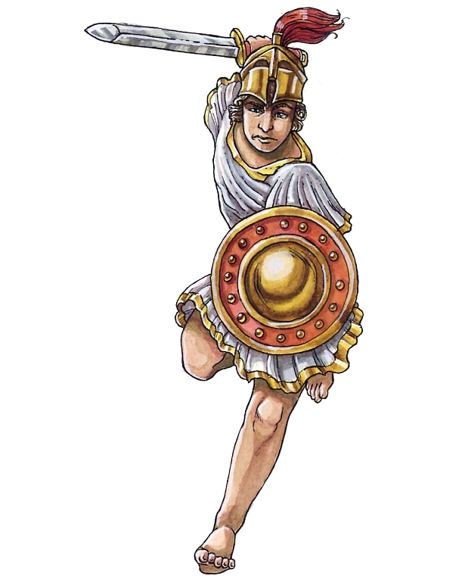
Mars
Diameter: 4,217 miles (6,787 km)
Mass: 6.4171×10^23kg (0.107 Earths)
Composition by volume:
95.97% carbon dioxide
1.93% argon
1.89% nitrogen
0.146% oxygen
0.0557% carbon monoxide
Cost: 2,165,100 Credits

Slide 15
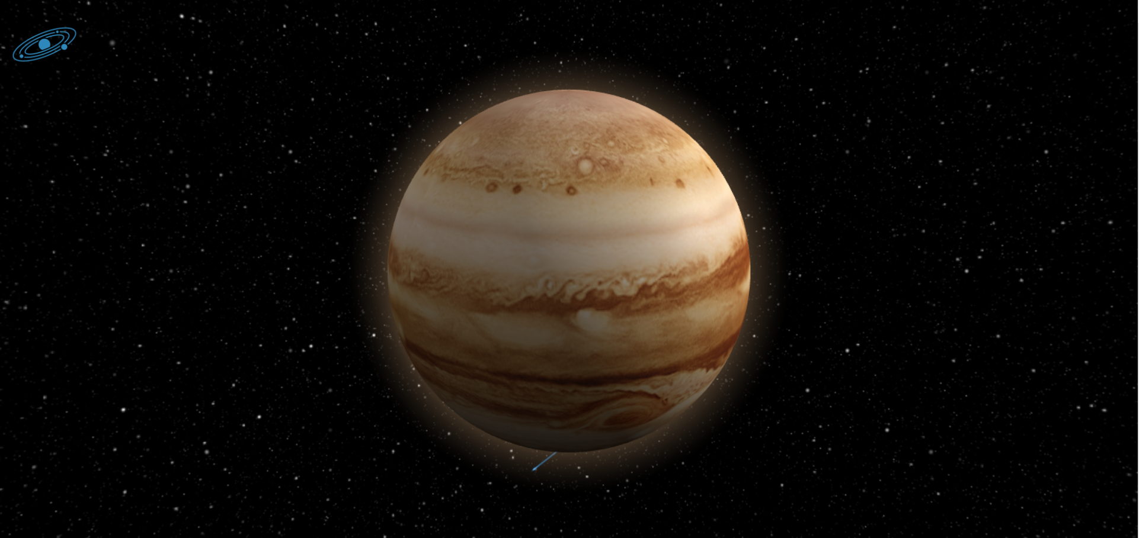
Jupiter

Slide 16
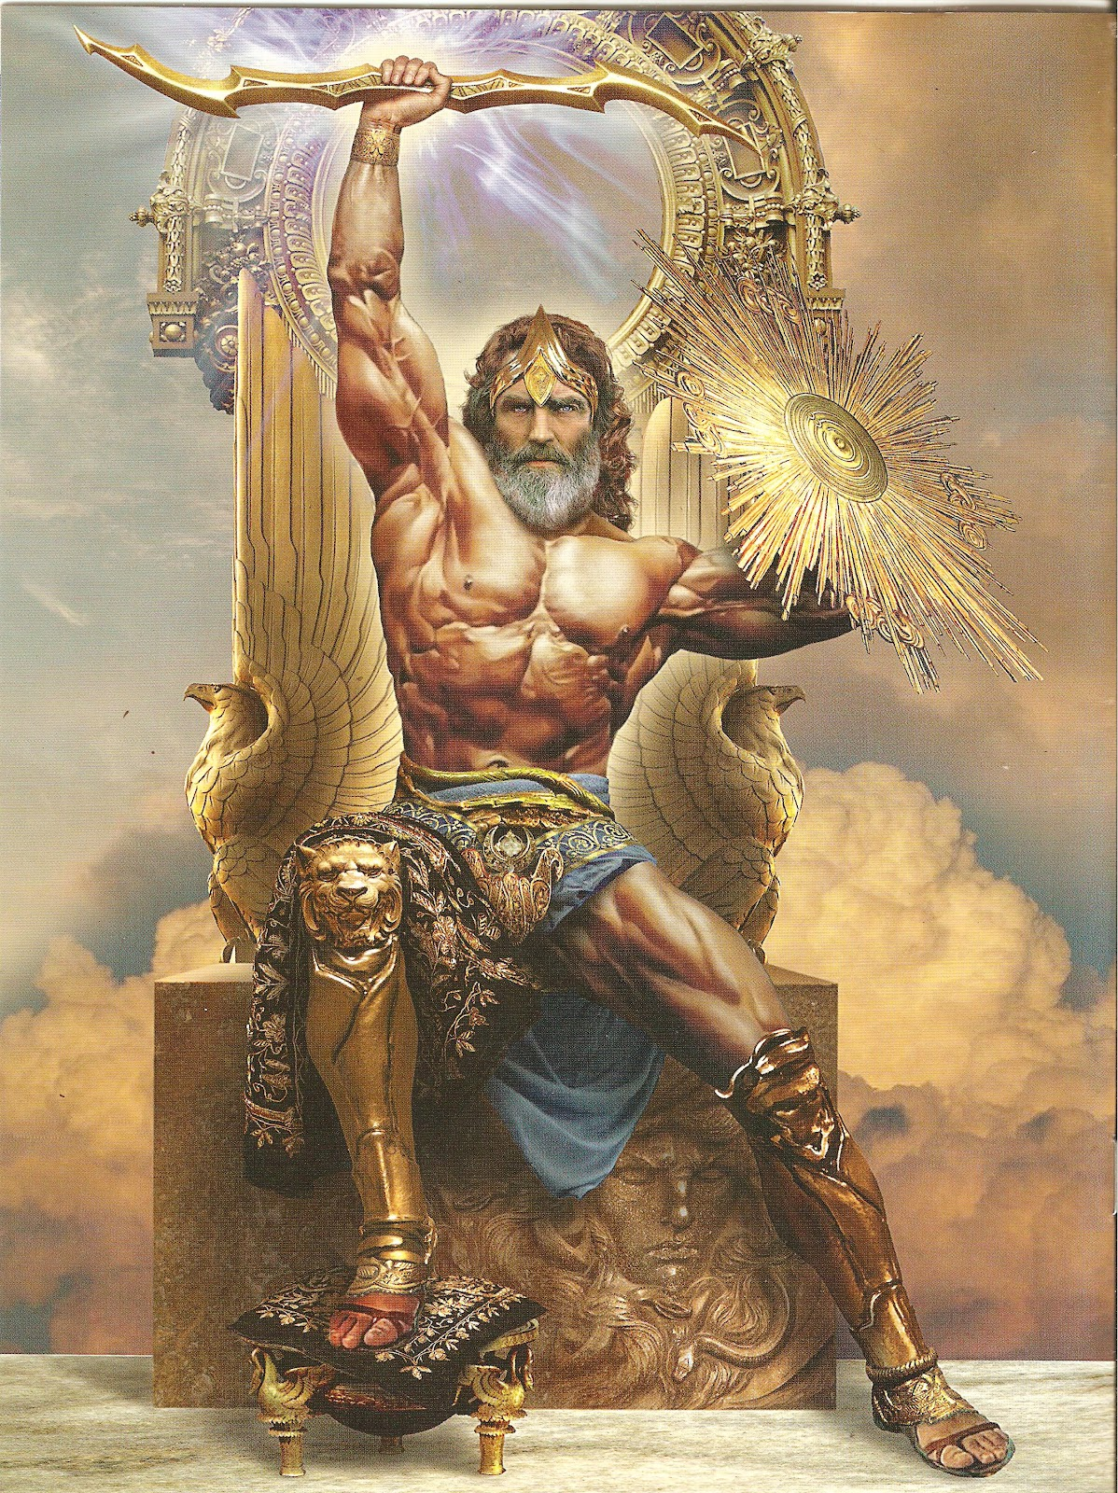
Jupiter
Diameter: 86,881 miles (139,822 km)
Mass: 1.8982×10^27kg (317.8 Earths)
Composition by volume:
89.8% hydrogen (H2)
10.2% helium (He)
0.3% methane (CH4)
Cost: 26,064,300 Credits

Slide 17
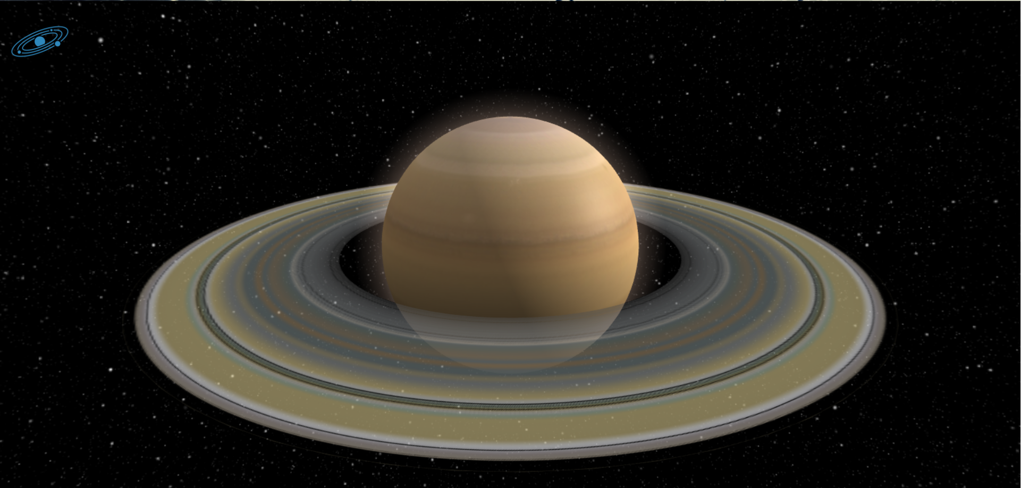
Saturn

Slide 18
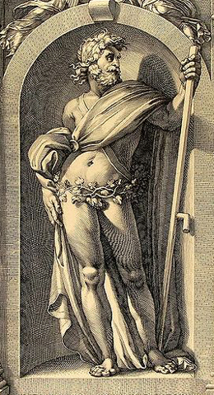
Saturn
Diameter: 74,900 miles (120,500 km)
Mass: 5.6834×10^26kg (95.159 Earths)
Composition by volume:
96.3% hydrogen (H2)
3.25% helium (He)
0.45% methane (CH4)
0.0125% ammonia (NH3)
0.0110% hydrogen deuteride (HD)
0.0007% ethane (C2H6)
Cost: 22,470,000 Credits

Slide 19
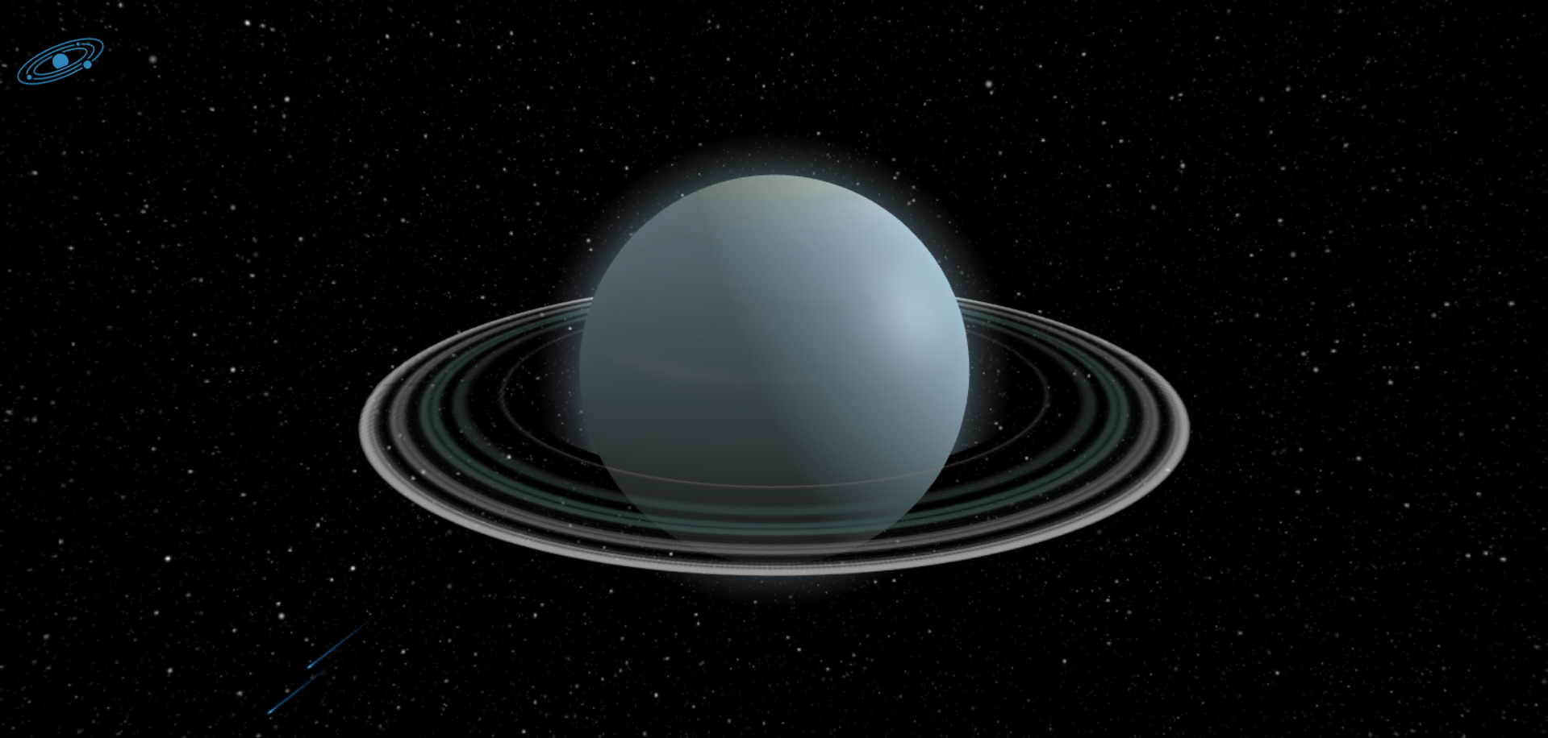
Uranus

Slide 20
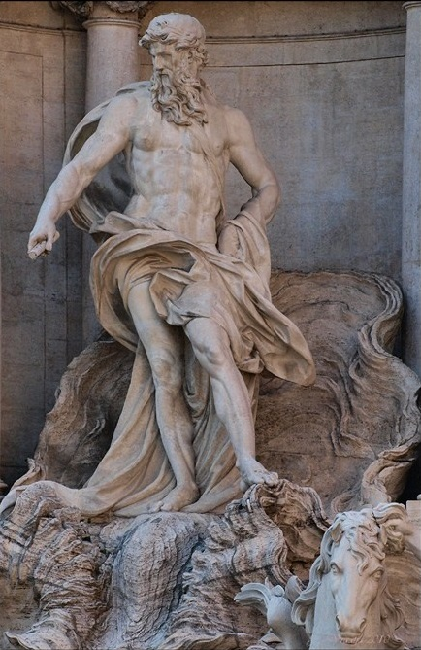
Uranus
Diameter: 31,763 miles (51,120 km)
Mass: 3.3011×10^23kg (0.055 Earths)
Composition by volume:
42% molecular oxygen
29.0% sodium
22.0% hydrogen
6.0% helium
0.5% potassium
Trace amounts of argon, nitrogen, carbon dioxide, water vapor, xenon, krypton, and neon
Cost: 909,300 Credits

Slide 21
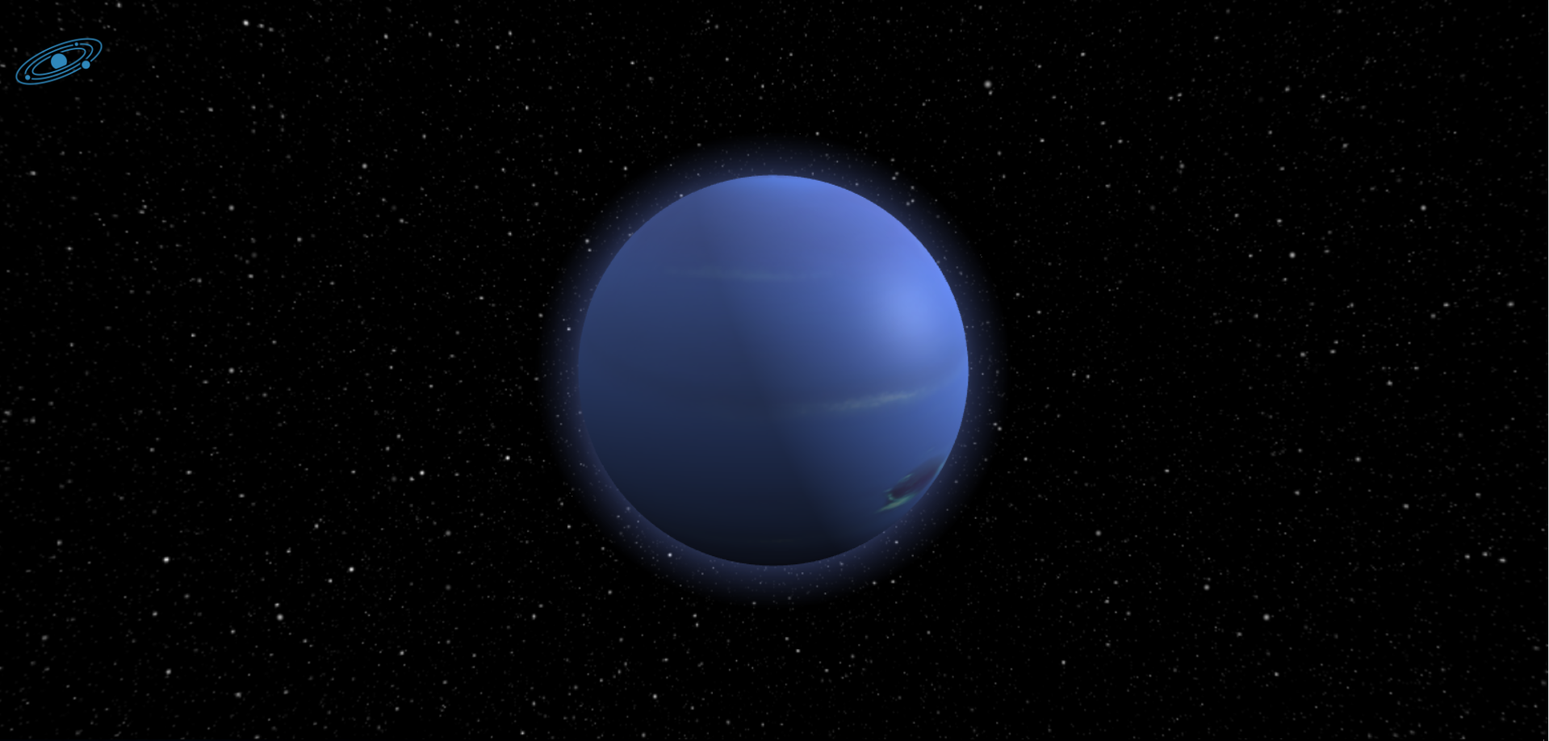
Neptune

Slide 22

Neptune
Diameter: 30,775 miles (49,530 km)
Mass: 1.0243×10^26kg (17.147 Earths)
Composition by volume:
80% hydrogen (H2)
19% helium (He)
1.5% methane (CH4)
~0.019% hydrogen deuteride (HD)
~0.00015% ethane (C2H6)
Cost: 9,232,500 Credits

Slide 23
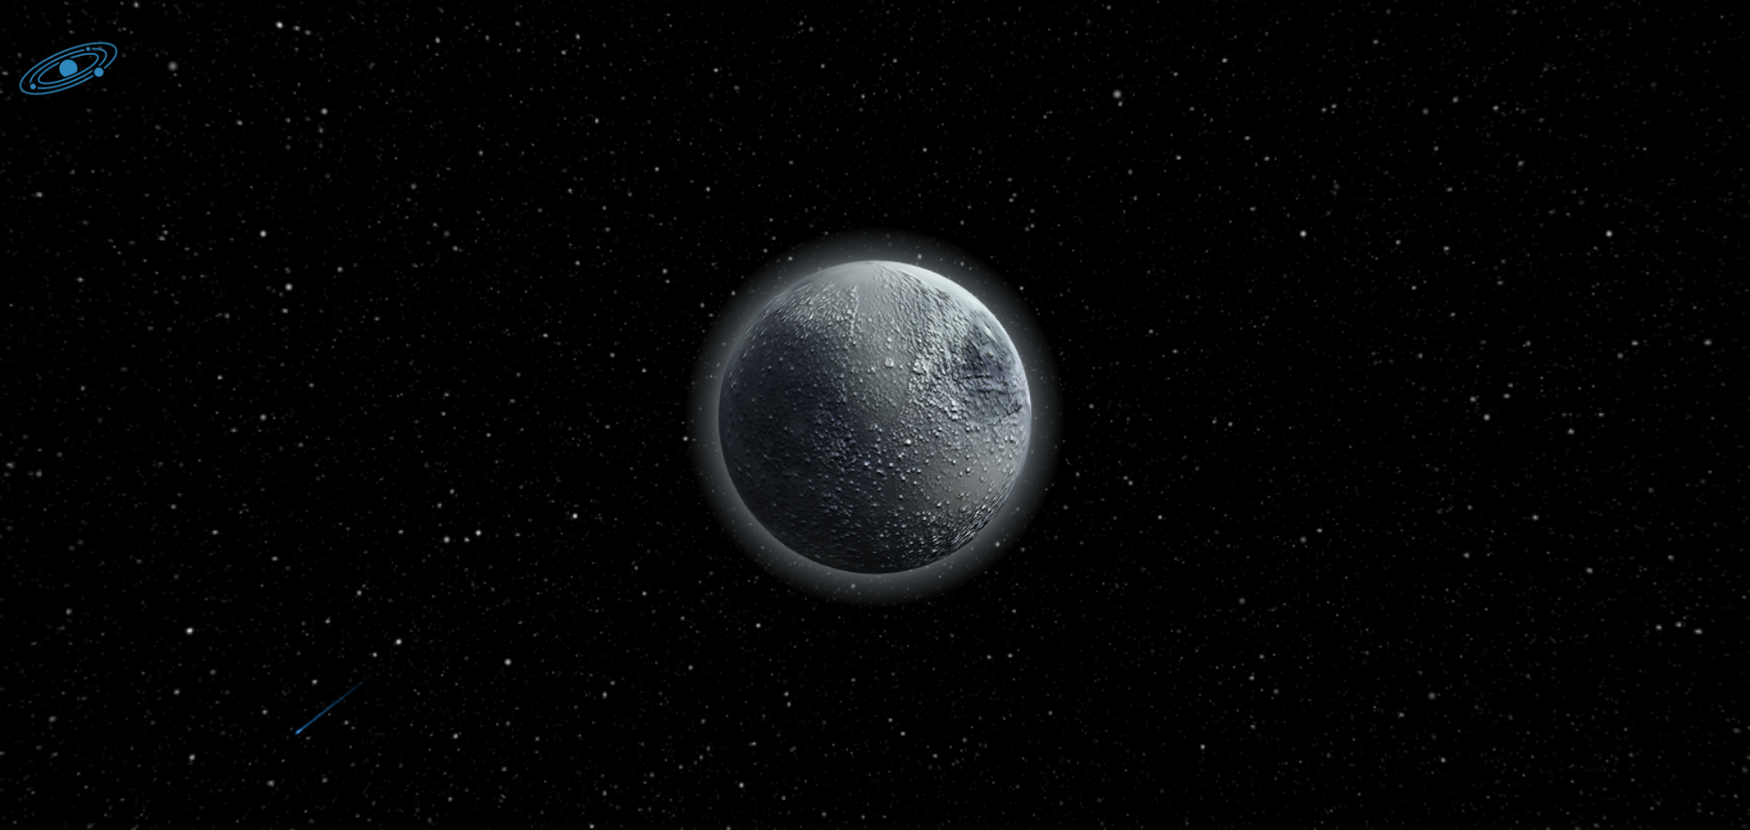
pluto

Slide 24

Pluto
Diameter: 1,430 miles (2,301 km)
Mass: 1.303×10^22 kg (0.00218 Earths)
Composition:
Nitrogen
Methane
Carbon Monoxide
Cost: 909,300 Credits

